Slide 1

Penn State Abington CRIMJ USER FRIENDLY ADVISING PROJECT
CRIMINAL JUSTICE DEGREES:
Bachelor of Science (BS) & BACHELOR OF ARTS (BA)
Lisa Morris LXV2@psu.edu FALL 2022
Develop an interactive instrument for advisors to learn degree requirements and for students to keep track of degree requirements.

Slide 2
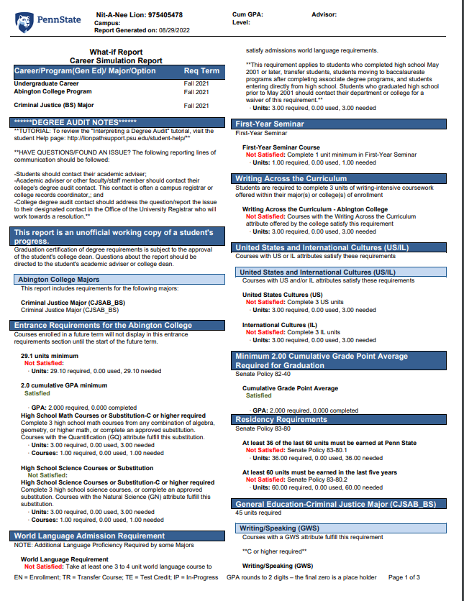
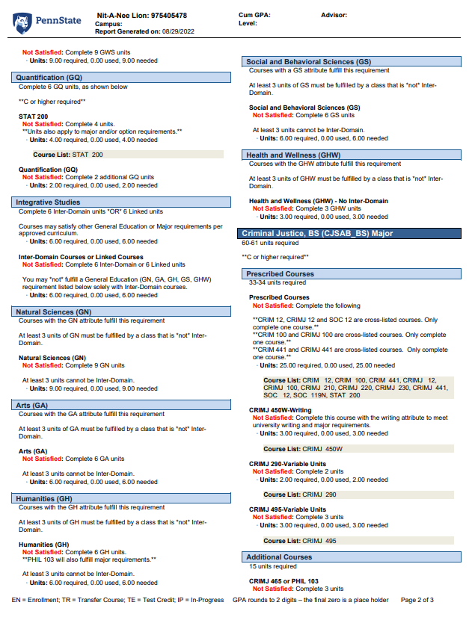
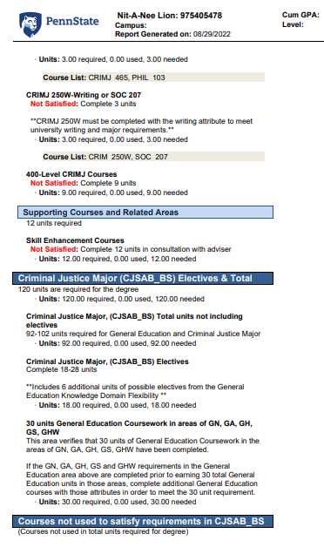

CRIMJ – BS degree REQUIREMENTS

Slide 3
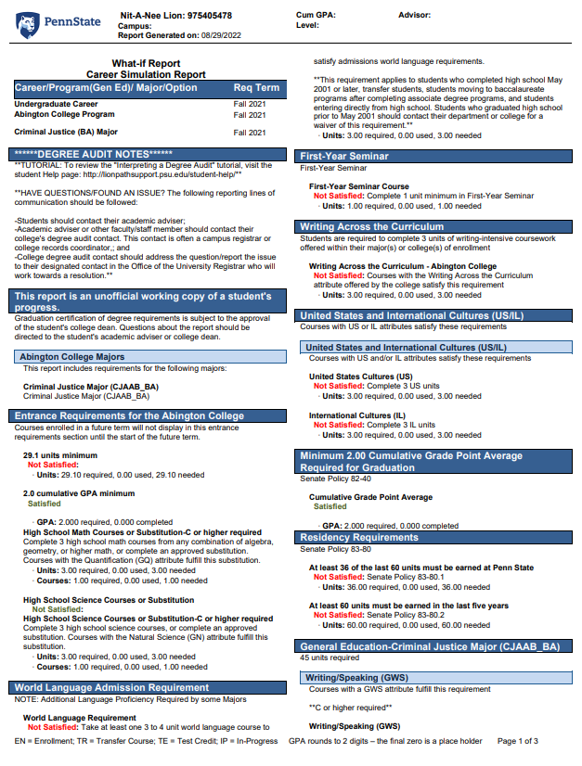
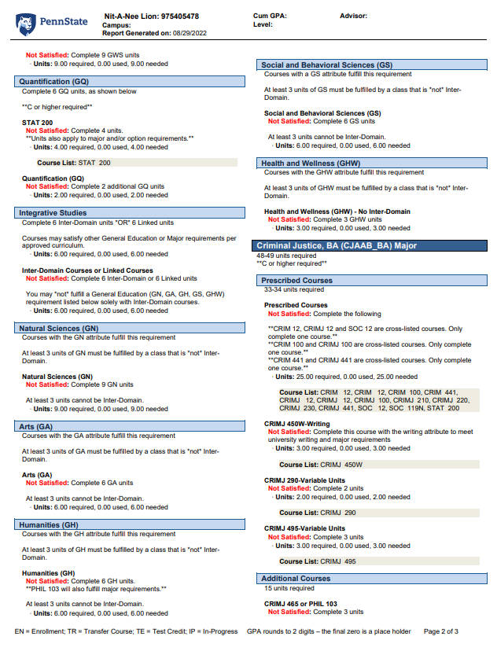
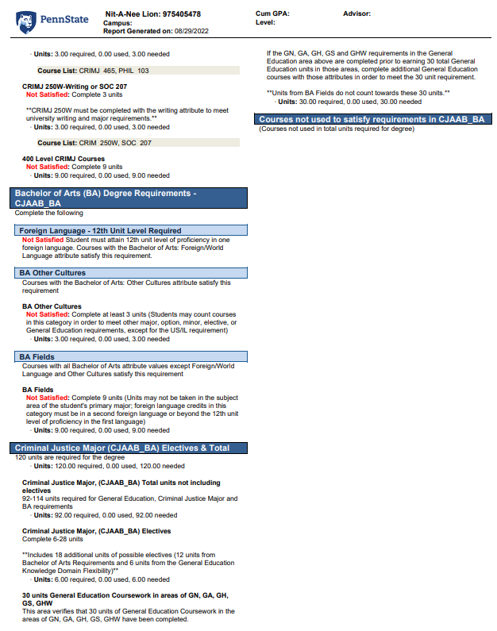

CRIMJ – BA degree REQUIREMENTS

Slide 4

Enter … Excel

Slide 5
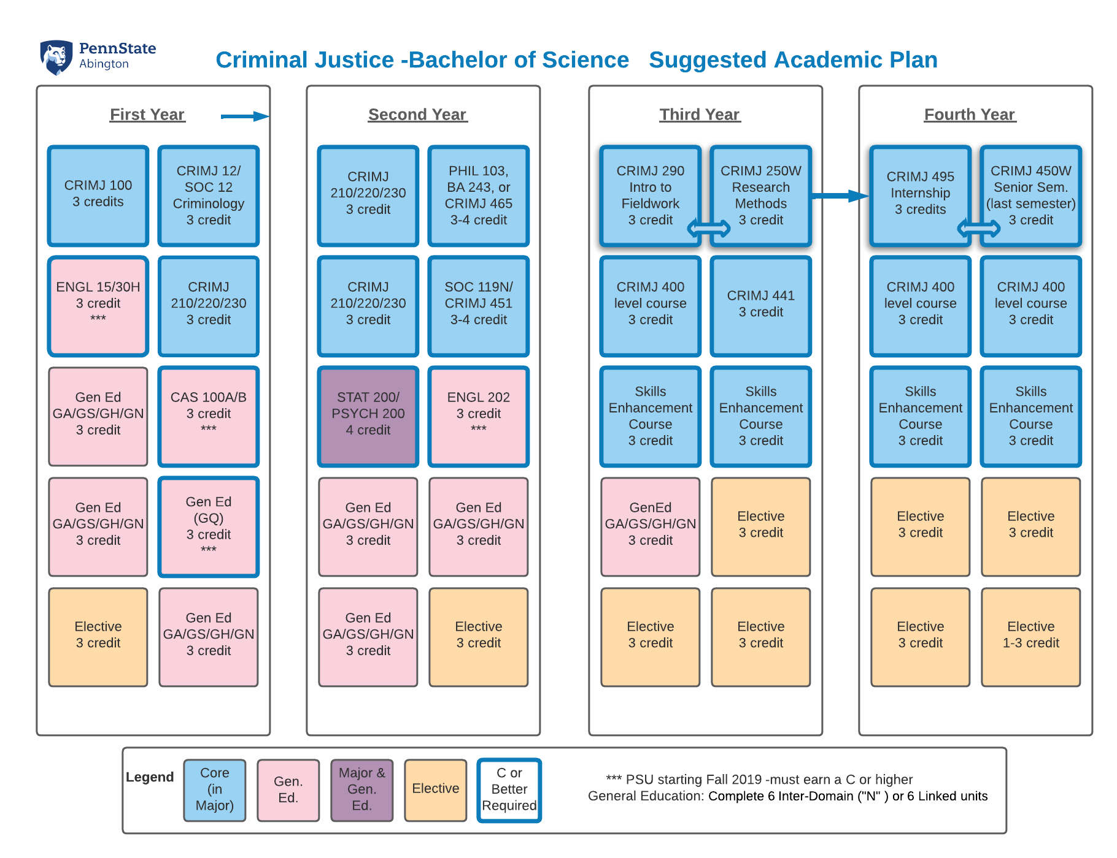

Enter … LucidChart (BS)

Slide 6
Post Presentation Notes:
Please do Bachelor of Science requirements first (more BS majors).
Pop-up Window example: There are 3 tiles with “Skills Enhancement” It would be great to be able to write-in the courses that are used for this requirement.
Pop-Up Window example: for CRIMJ 290: “Intro to Fieldwork” – Taken Prior to or concurrently with CRIMJ 250W (Prior to Professional Internship).
Pop-up Window example: CRIMJ 450W – Taken after internship or concurrently, Sennior year, preferably last semester.

Slide 7
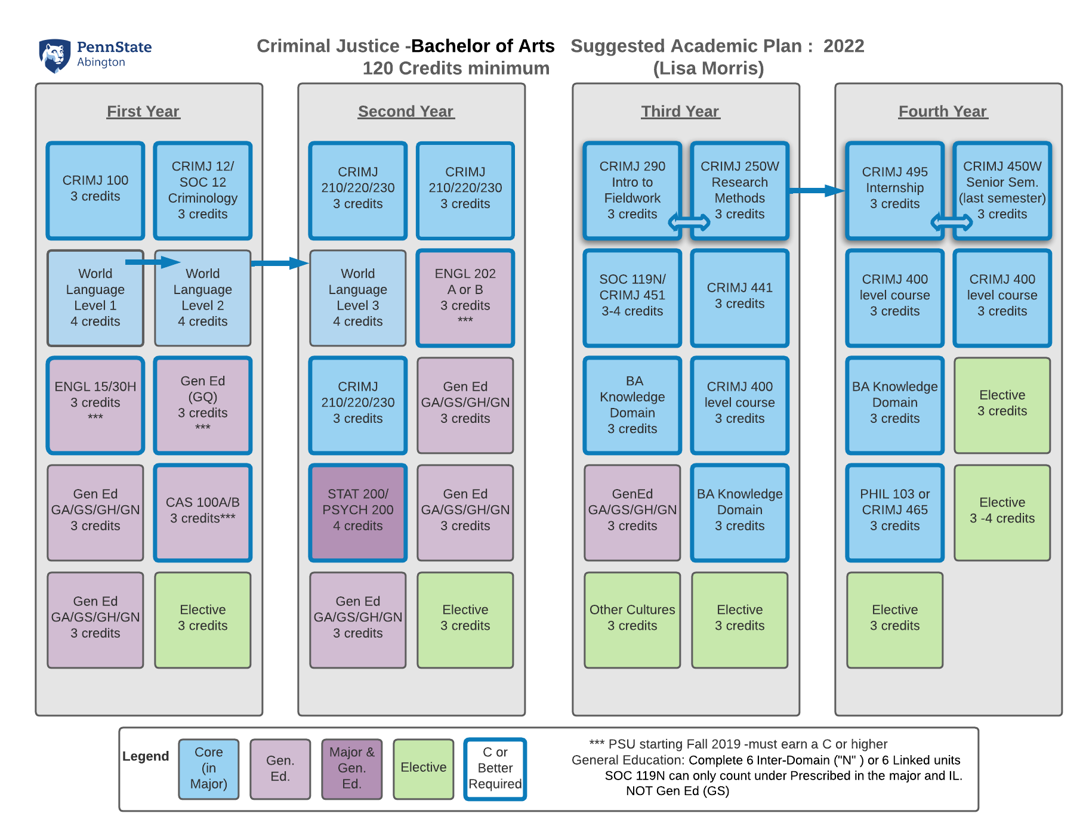

Enter … LucidChart (BA)

Slide 8

Challenge
Can an interactive program be created where students can check off requirements as completed (Perhaps they slightly grey out ) and it is clear to see what requirements are remaining to complete graduation requirements?
Can it have pop-up windows of information ? (example indicating sequence in sequential courses?)
Possible to make each square a “tile” and move the tiles to different semesters if completed in different order?

